Slide 1
Mid-time project presentation
Made by:
Ignacio Villanueva
Mokhtar Sellami
CSED 332: Software Design methods
21 November 2024

Slide 2
Project Goal and Motivation
Project Overview
Why is distributed sorting important for large datasets?
When datasets are too large for one machine to handle. It is necessary to distribute the data to different machines that work under the coordination of one master who handles management orders.
Overview of sorting large binary records in distributed systems

Slide 3
Project Management and Organisation
Plan:
Meeting twice a week just after weekly sessions, sometimes also in the weekend.
Done:
Meetings once or twice a week for 20-30 minutes to discuss advancements and goals
A 2 hour first meeting for the design
We made a document for the Github policies (strategy, start of working sessions, branches)

Slide 4
Problem Scope and Constraints
Constraints:
Memory,
Disk space,
Large data size and external sorting,
Coordination of the workers.
Lack of experience in similar projects (networking, parallelism).
Scope: sorting records using master-worker architecture.

Slide 5
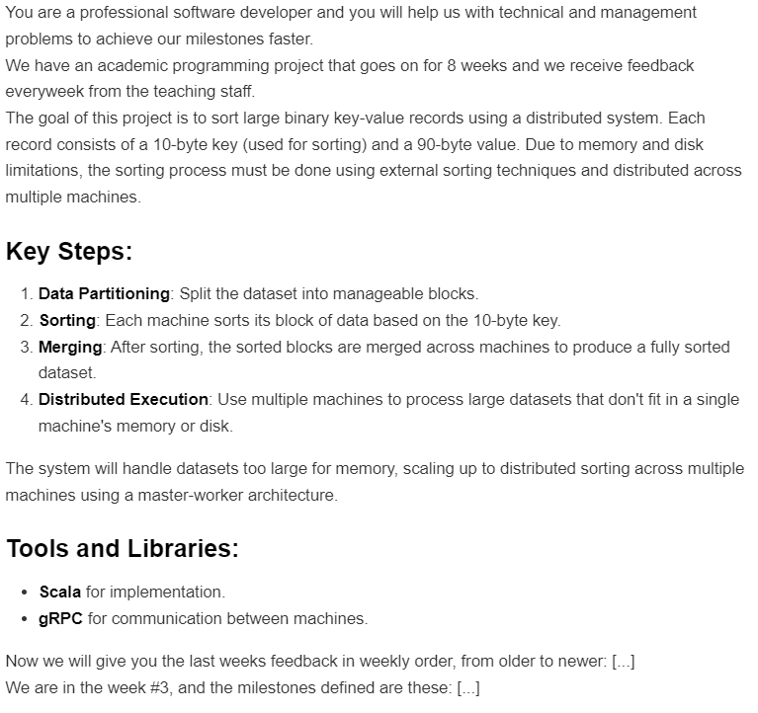
ChatGPT usage
In our relation with ChatGPT as a tool we found ourselves in 3 levels of dependance:
Full dependence (with understanding the concepts): Project Structure, gRPC coding…
First kick : milestones
Verification only: after our main progress on the design of the solution
Since first week we recycled this prompt on the right so we could keep ChatGPT updated with the cumulative progress and not lose much time re-explaining context.

Slide 6
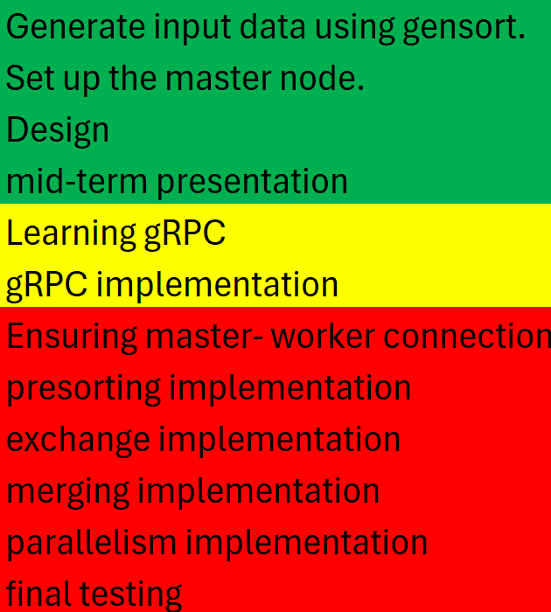
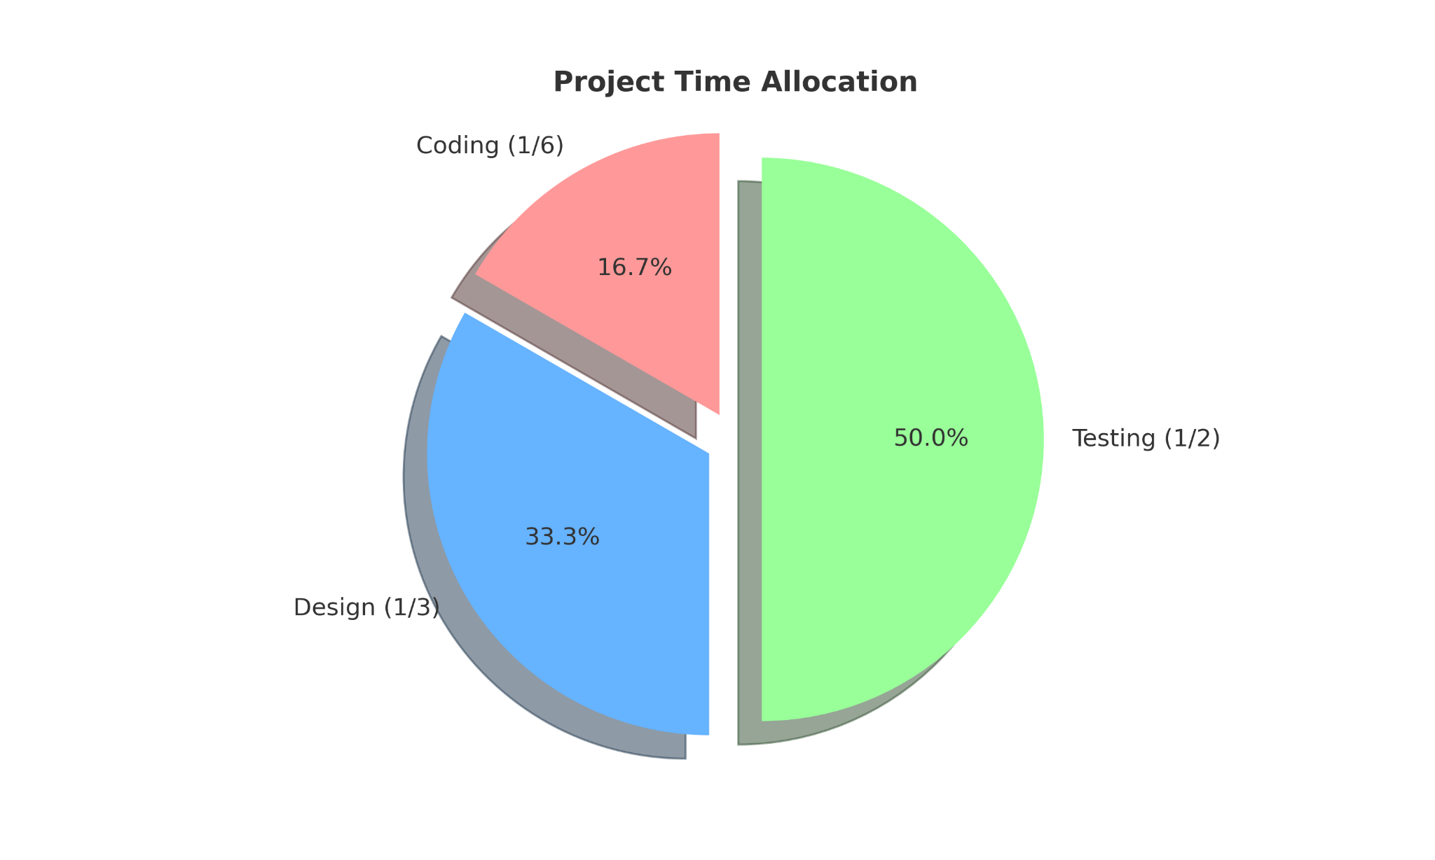
Milestones and Timeline

Slide 7
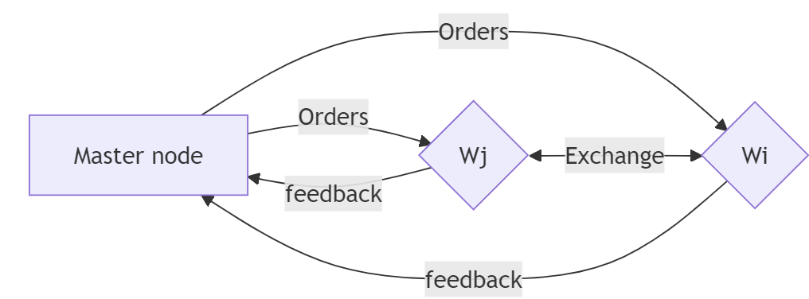
Design and architecture
High-Level System Design:
Description of the components:
Master: Manages the roles of workers, gives orders and receives responses from workers
Workers: perform the sorting, communicate and receive orders from master, can exchange data with each other

Slide 8
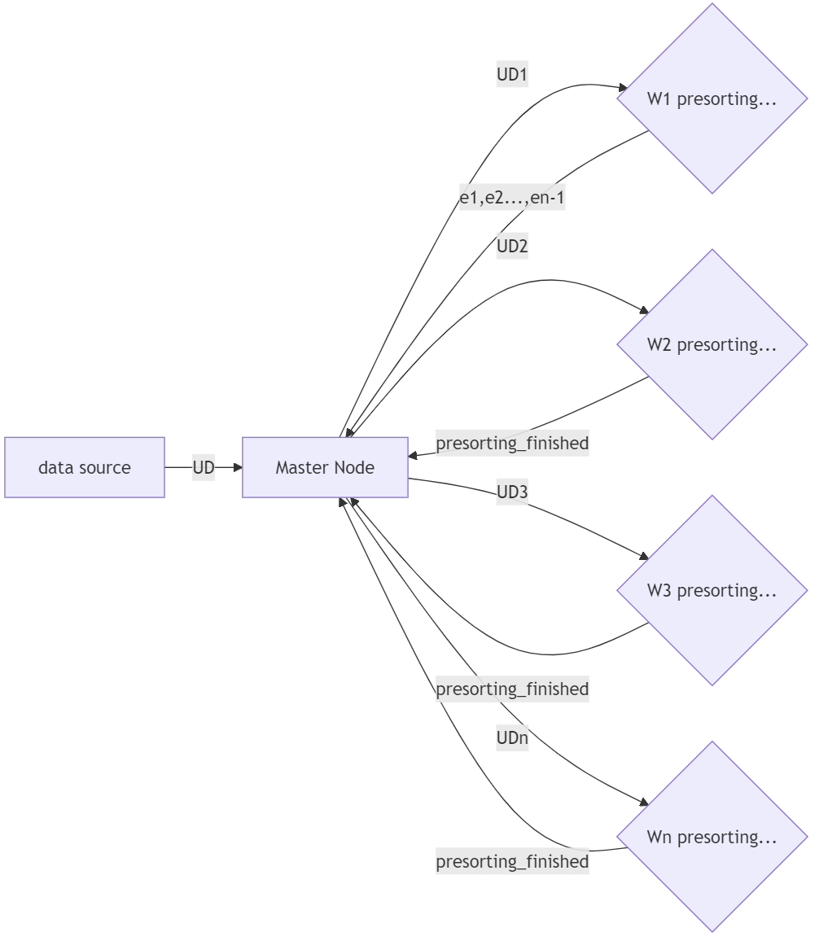
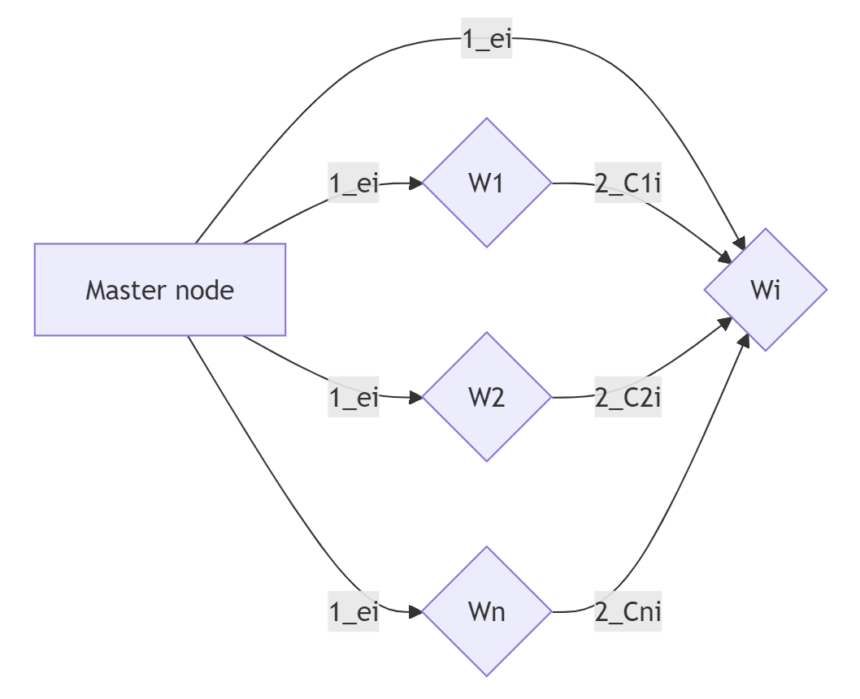
Design

Slide 9

Master Design Details
Worker Design Details:
Expected Master responsibilities:
ordering workers
manage the exchange between workers
Current progress:
Started coding for communication,
We need the connection with the workers to be established to debug and implement the role according to our design.
Question: is the master our computer or one of the machines?
Expected worker responsibilities:
Presorting and sorting data
Exchanging data with other workers
Give feedback to master when finishing every step

Slide 10
Challenges and Solutions
Planned Solutions
Challenges Faced
Difficulty connecting to the machines
Uncertainty about hardware setup (master on personal or university machine)
Limited clarity on performance metrics
Trying master-worker connections by exchanging dummy messages
Trying the instructions of the last email to connect to the machines
Compare with other students’ metrics

Slide 11
Next Steps and Closing
Next Milestones
Ensure that workers can connect to the master.
Ensure that the master and workers run smoothly together.
Implement presorting and merging across workers.
Implement exchange between workers.
Optimize parallelism by exploiting multiple cores.
Final testing and submission by the project deadline (Dec 8).

Slide 12
Expected Outcomes
Fully functional distributed sorting system.
Once the execution finished, Worker 1 should have the first batch of sorted data, Worker 2 the next batch and so on. Every batch size should be around 50GB
Metrics:
runtime,
memory usage,
probably we can define more things here.

Slide 13
End
Thank you all for listening.
We would love to have your feedback on our approach.

